Slide 1


JAWAHARLAL DARDA INSITUTE OF ENGINEERING AND TECHNOLOGY,YAVATMAL
Department of Computer Science and Engineering
2023-2024
“ Movie Character Recognition From Video and Image Using AI ”
Presented by
1] Arpit Meshram 2] Hindav Deshmukh
3] Priya Khivasara 4] Vishakha Tandulkar
Guided by:-
Prof. Pravin S. Bhagat

Slide 2
CONTENT
1) INTRODUCTION
2) OBJECTIVE
3) IMAGE RECOGNITION ROADMAP
4) RESEARCH METHODOLOGY
5) FLOW CHART
6) ALGORITHMS
7) CONCLUSION
8) REFERENCE

Slide 3


INTRODUCTION
Its a groundbreaking for easy identification of actors in movies. Utilizes smart computer vision and artificial intelligence for automatic actor detection in video or image frames. Not just for movie enthusiasts; offers new possibilities for content analysis, audience engagement, and marketing strategies. Enhances the movie-watching experience by providing instant information about the actors on screen. A tool that bridges technology and the joy of cinema, ensuring you never miss a moment with your favorite actors. Welcome to a new era where technology seamlessly integrates with the magic of the movies.

Slide 4

OBJECTIVE
Create a model for automatic character classification from a dataset.
Develop a one-time model for predictions from images or video.
Enable live tracking of movie characters for automated classification.
Utilize the system for real-time testing with live video or images of trained characters.

Slide 5
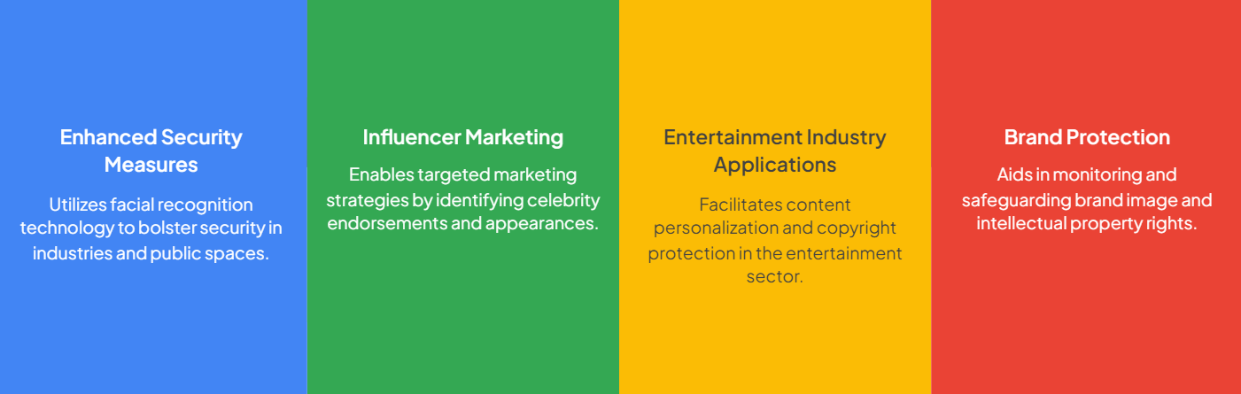
Importance of Celebrity Face Recognition

Slide 6

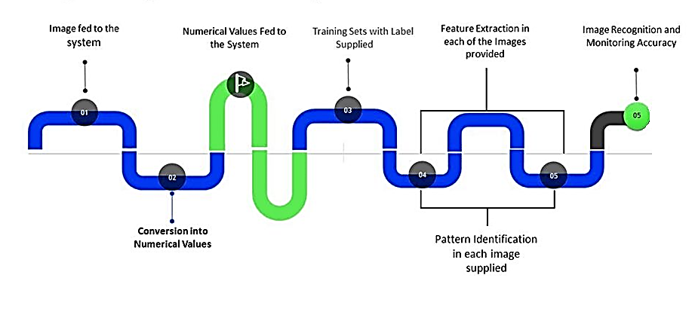
IMAGE RECOGNITION ROADMAP

Slide 7




RESEARCH METHODOLOGY
A. Data Collection :
Collect diverse movie data from online sources.
C. Labeling Actor Data :
Assign unique labels to each actor's face for identity representation.
Data Collection
Labeling Actor Data
B. Data Pre-Processing :
Improve accuracy with essential pre-processing.
D. Training and Testing :
Train recognition model using pre-processed frames and actor labels.
Data Pre-Processing
Training and Testing

Slide 8
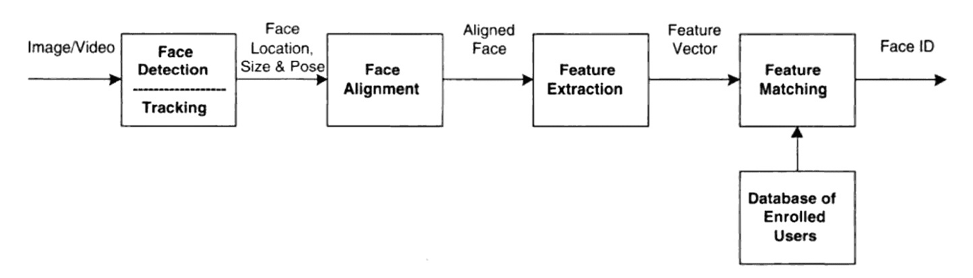


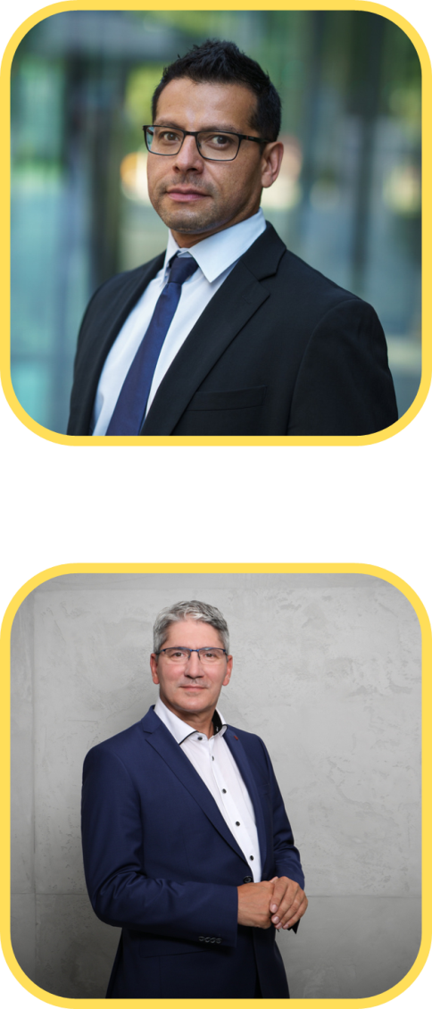
FlOW CHART
Id: 001
Id: 002
Id: 003
Id: 004

Slide 9

SCREENSHOTS

Slide 10
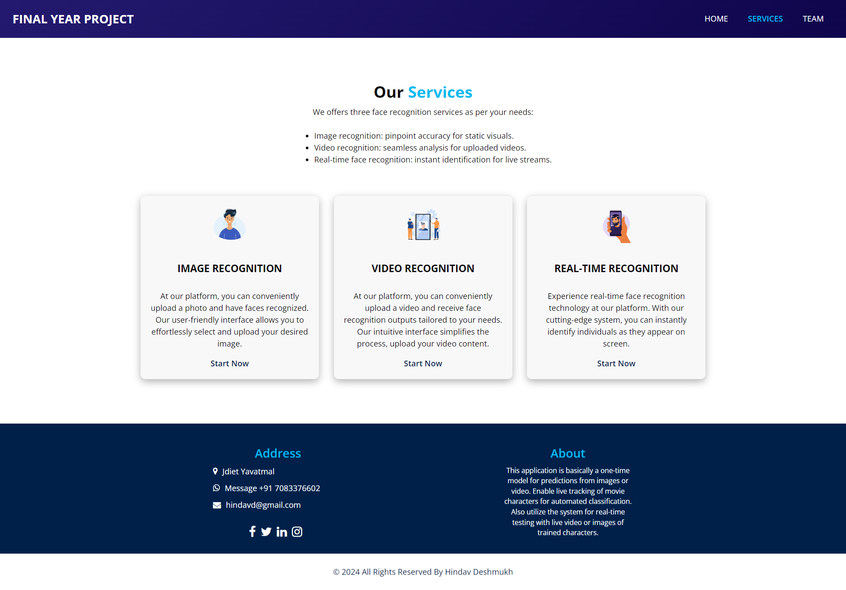
SCREENSHOTS

Slide 11
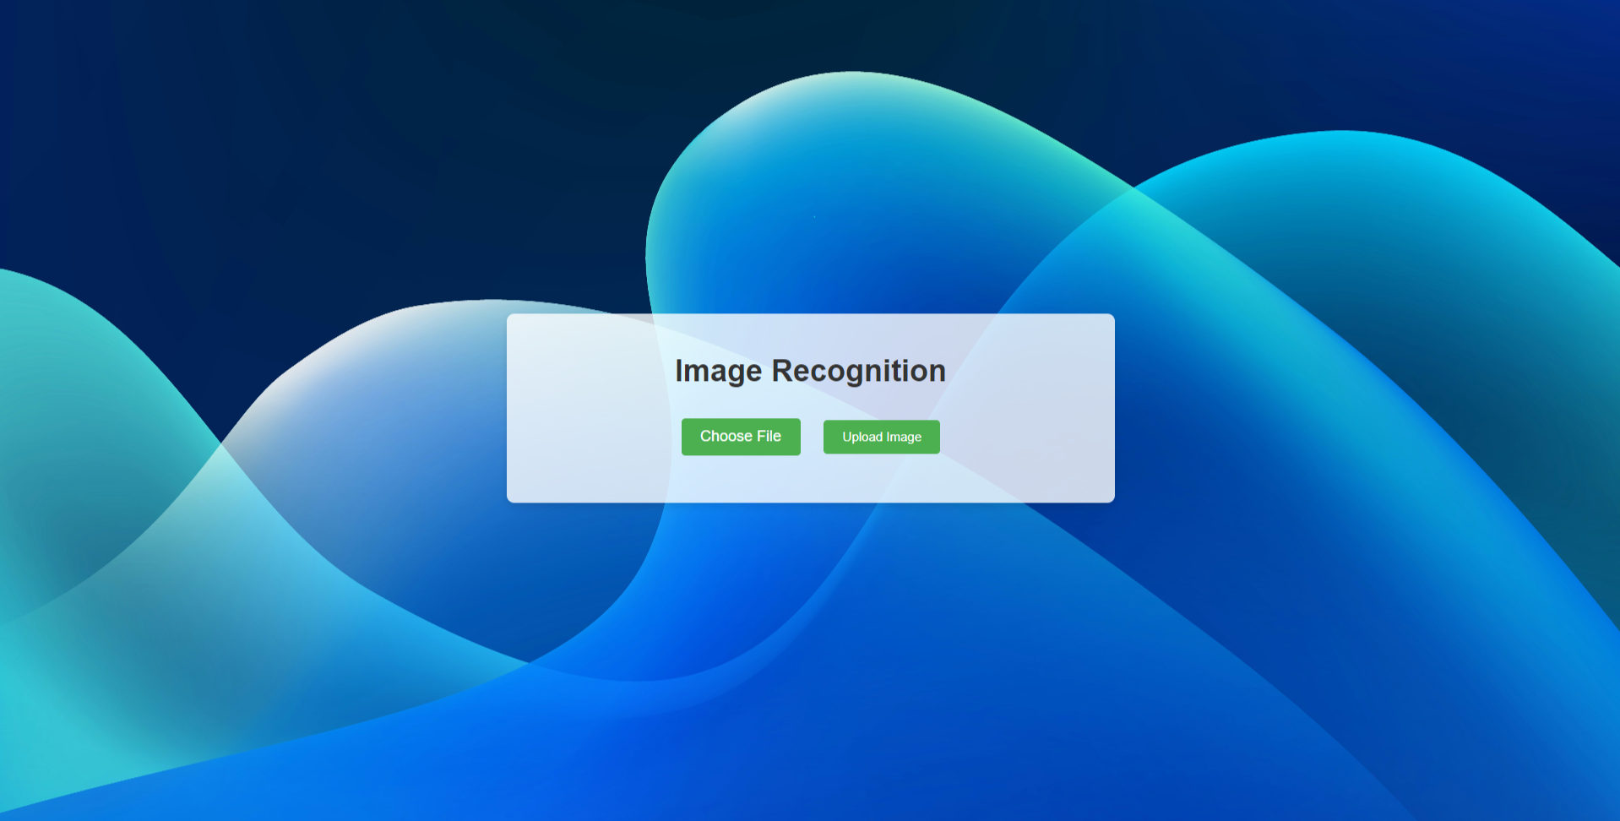
SCREENSHOTS

Slide 12
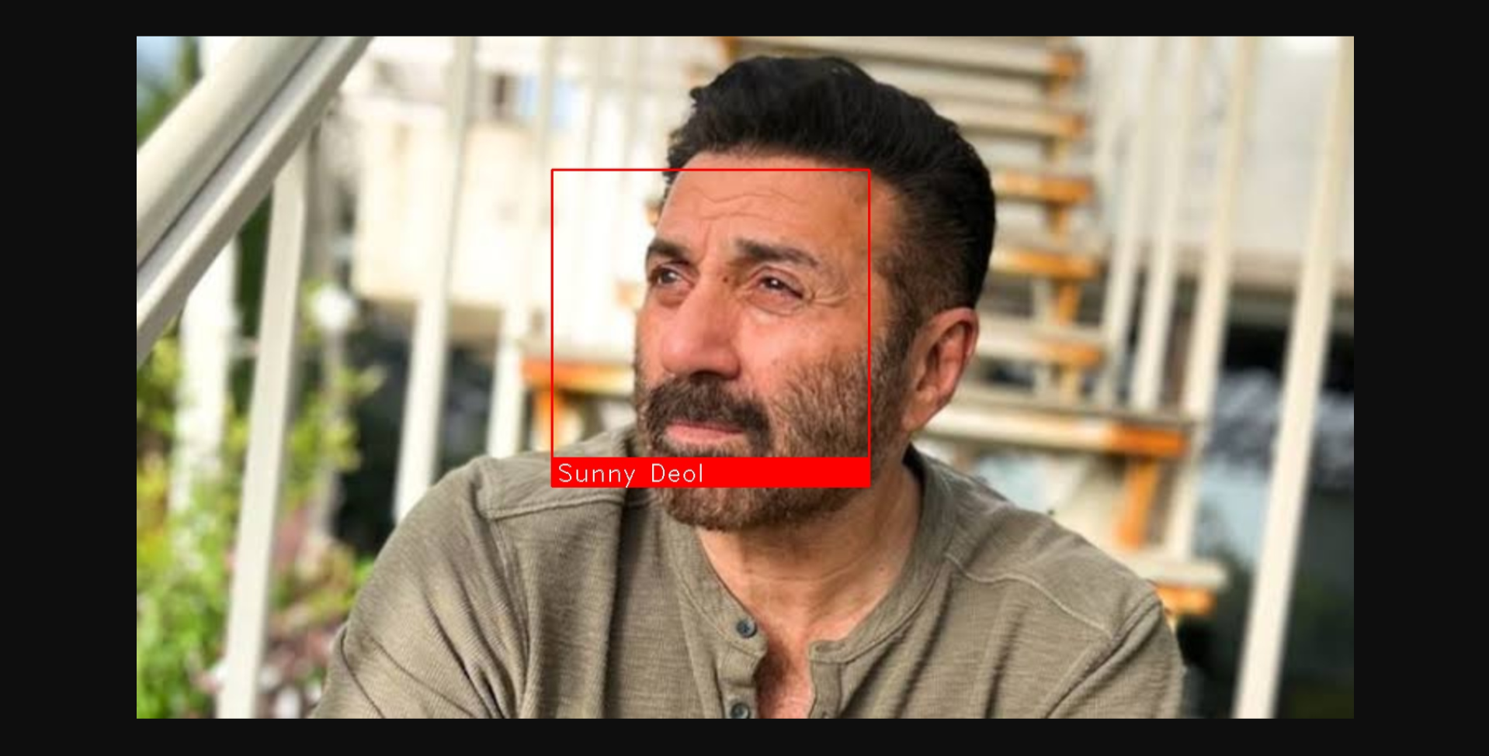
SCREENSHOTS

Slide 13
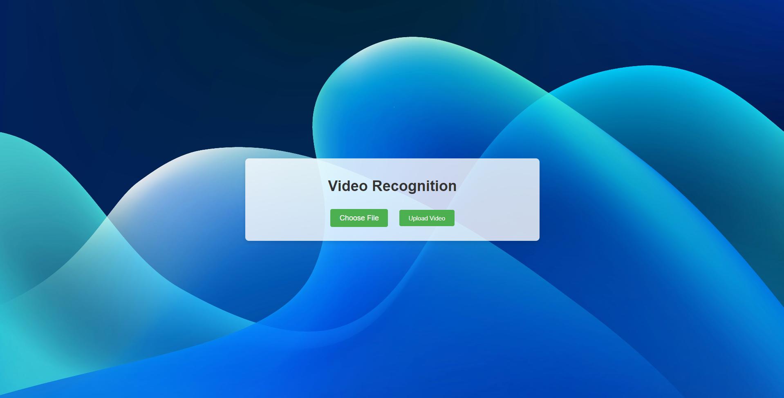
SCREENSHOTS

Slide 14
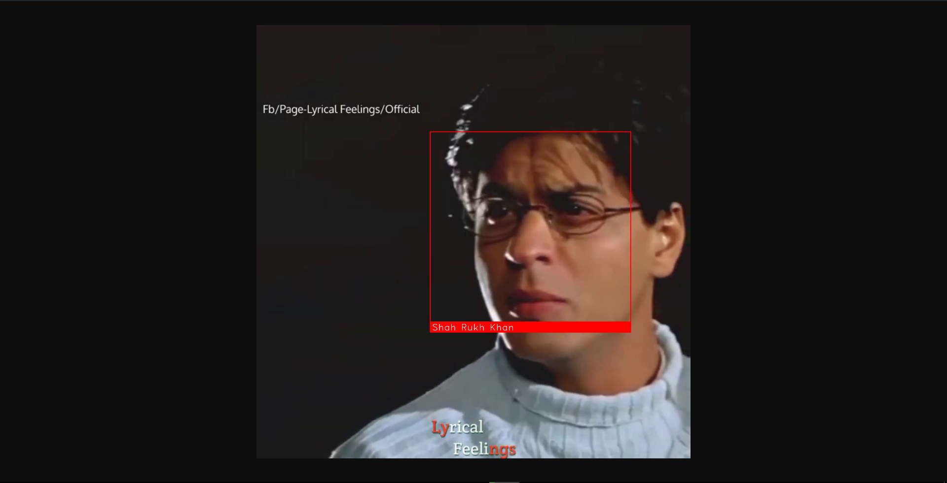
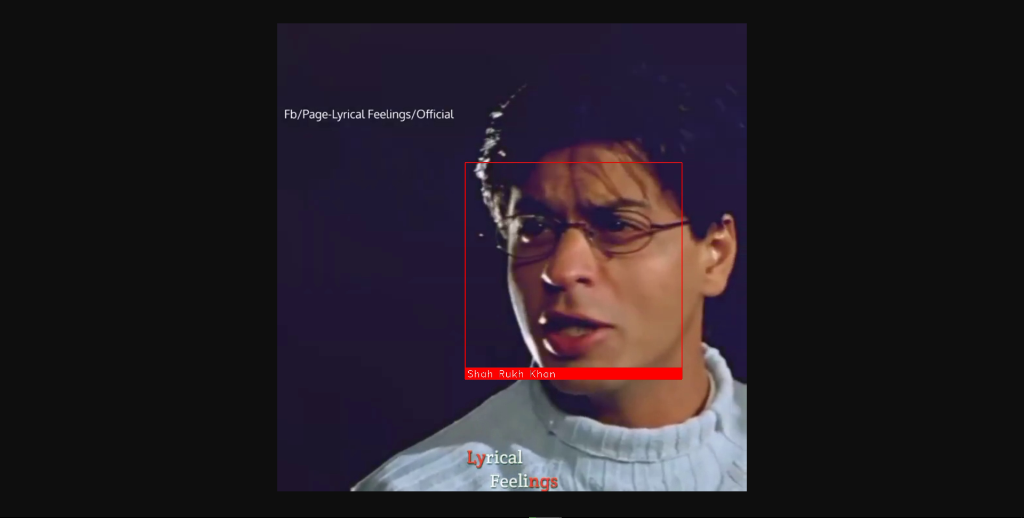
SCREENSHOTS

Slide 15

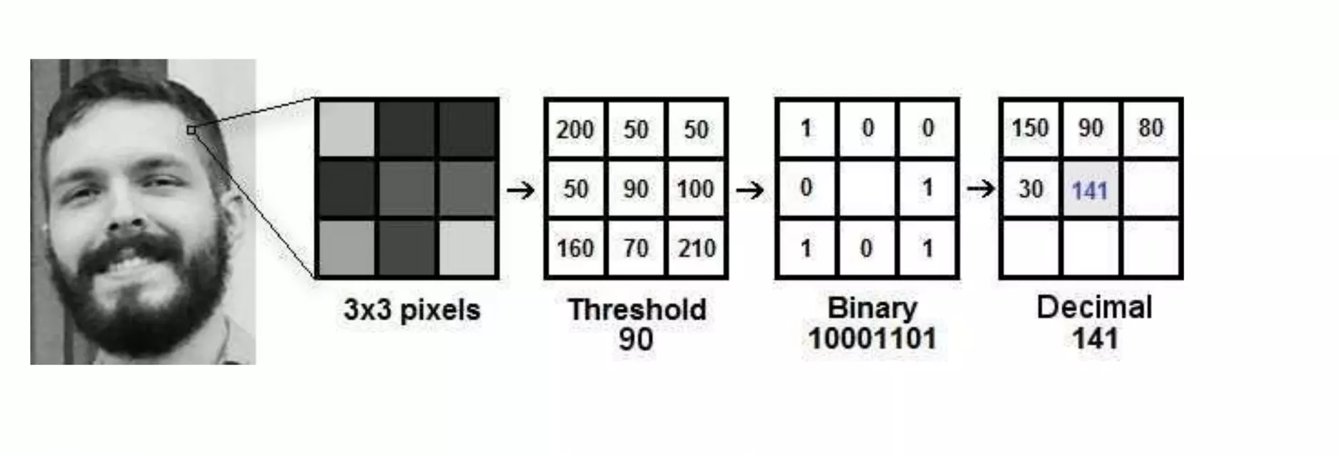
ALGORITHMS
1
LBPH ALGORITHM
Local Binary Pattern is simple but efficient texture operator.
It is combined with HOG (Histogram of Gradients) to recognize faces in image.

Slide 16
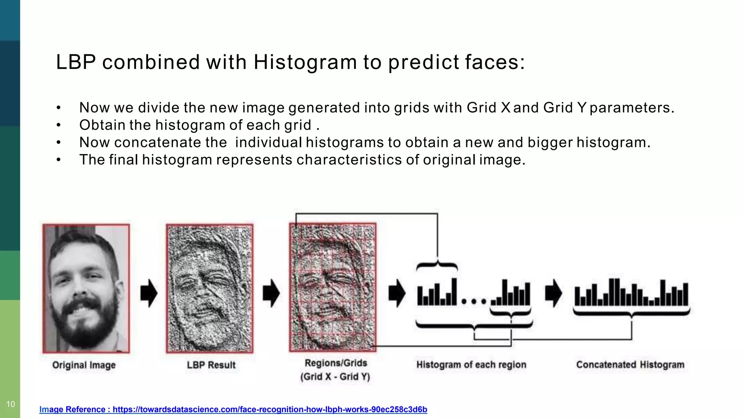
2
HOG is a feature descriptor that captures the shape and gradient information within an image patch. It’s commonly used for OBJ detection tasks like face detection.
HOG
(Histogram of Oriented Gradients)

Slide 17
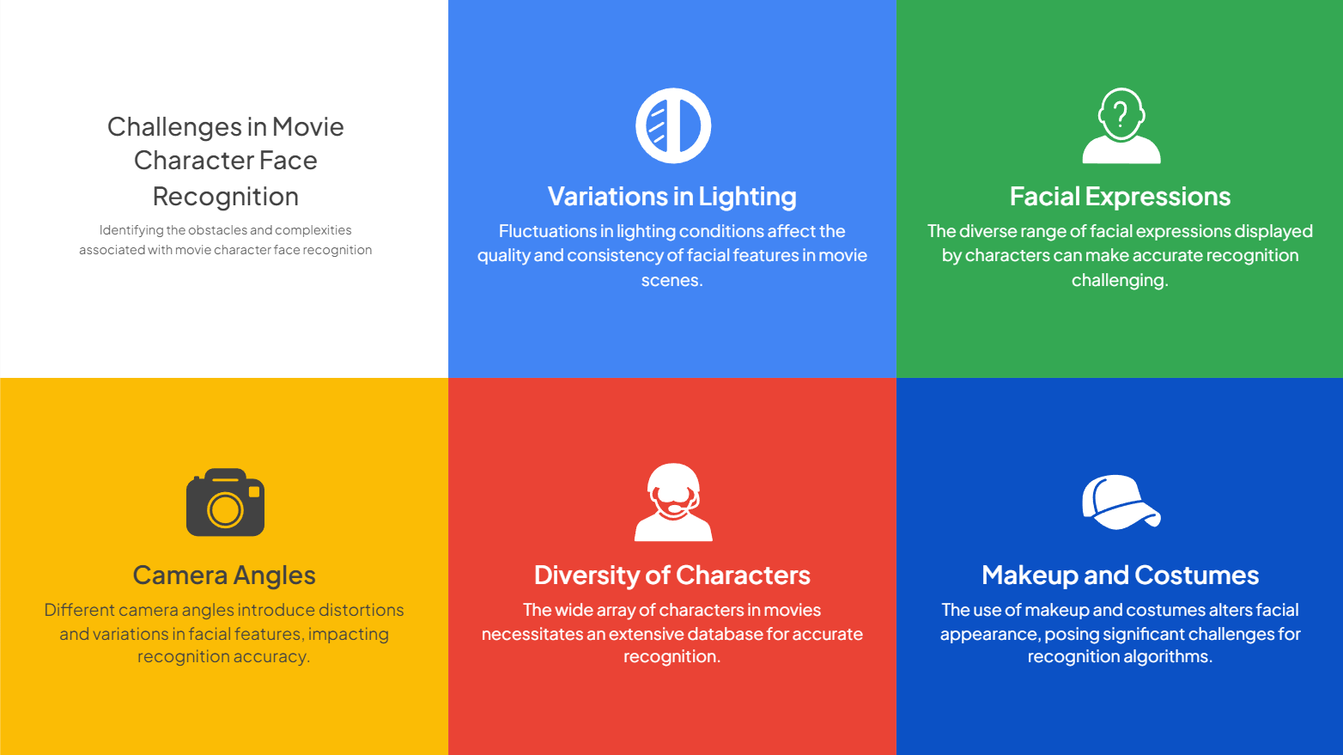

Slide 18
SYSTEM REQUIREMENT
Hardware
Requirement
Software Requirement
Python Library Requirement
Computer System
GPU
Python Software IDE
OpenCV
Dlib
Face_recognition
Other basic python library

Slide 19
CONCLUSION
Movie character recognition from video and image using AI is a project that aims to automate the process of character classification in movies. The project involves collecting a dataset of movie characters and training a model that captures their facial features using image processing techniques and the KDD Tree algorithm. The trained model can be used to track live video and automate the process of detecting characters. The software requirements for the project include Windows XP/7/10 operating system, Python coding language, Anaconda development kit, TensorFlow, Keras, OpenCV libraries, and any movie dataset. The project can also be extended to predicting the success of movie scripts, selecting actors, and editing movies using AI algorithms.

Slide 20
REFERENCES
[1]. Yang, Hao, and Xiaofeng Han. "Face recognition attendance system based on
real-time video processing." IEEE Access 8 (2020)
[2]. Suresh, V., S. Chakravarthi Dumpa, C. Deepak Vankayala, H. Aduri, and J. Rapa.
"Facial recognition attendance system using python and OpenCv." Quest
Journals-Journal of Software Engineering and Simulation 5, no. 2 (2019)
[3]. Ravindranadh, J., and Peram Venkata Ravindra Reddy. "PYTHON Based Attendance System." (2020)
[4]. Gupta, Naman, Purushottam Sharma, Vikas Deep, and Vinod Kumar Shukla.
"Automated attendance system using OpenCV." In (2020) 8th International Conference
on Reliability, Infocom Technologies and Optimization (Trends and Future
Directions)(ICRITO)
[5]. Solanki, Kamini, and Prashant Pittalia. "Review of face recognition techniques."
International Journal of Computer Applications 133, no. 12 (2016): 20-24.

Slide 21


